Slide 1
Threat Analysis and Risk Assessment
Bosch Global Software Technologies Pvt Ltd

Slide 2
Contents
TARA
What and Why?
Terminology
Methodology
Example & Exercise!

Slide 3
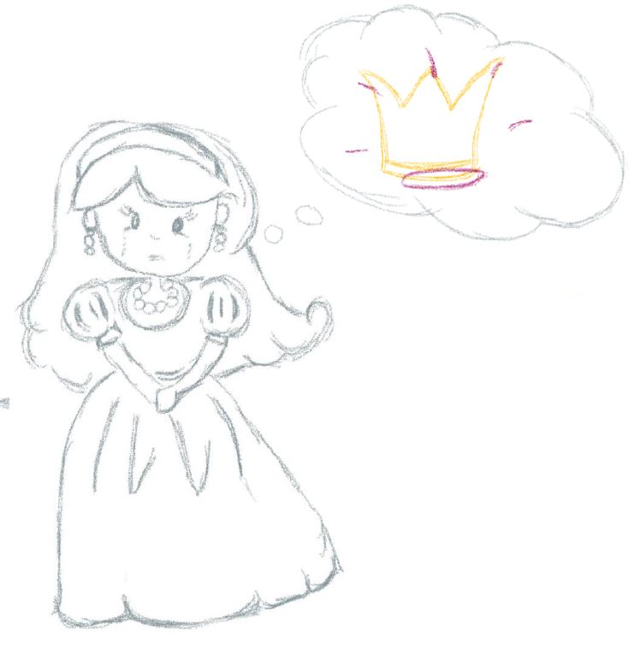
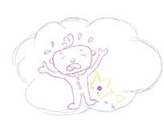
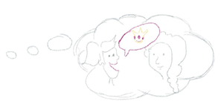
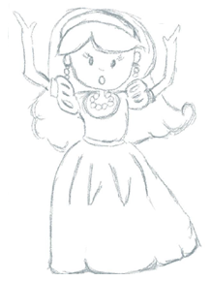
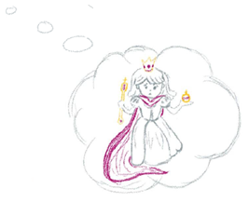
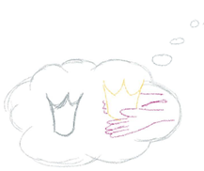
What and Why?
TARA
Notes:
Compare with real world security -> Extraction of Software/Firmware

Slide 4
What and Why?
TARA
Notes:
Why do we need a TARA? Why do we need Security?
Security deals with intentional manipulation. Does not happen because of faulty parts.
1. Asset is something that we need to protect. The Toy car has several good functionalities like remote, brake, etc.. Most of driving assistance.
The value of the car is very less 500 and hence we do not think about security here. But, lets assume that the same has to be done on the road. Then we need to thing of security as we need to sell to end user. HW, Code, Info etc are assets and we need to protect.
2. Lot of remote features are being introduced and car is no longer a mechanical device but more of an IOT device. Remote features comes with remote attacks.
3. Taking Selfies are causing compliance issue and we need to consider the background in car as well.
4. Human safety is now ensured by electronics and driver is replaced by the electronics. Now the electronics is now under attack,.
5. Safety system itself has to be secured. Wanted to control steering. What is someone manipulated the safety systems? We need to protect the safety systems as well.

Slide 5
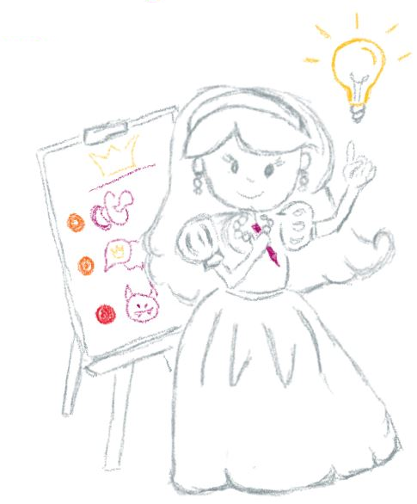
What and Why?
TARA
Structured documentation of threat scenarios and risks to a given system
Systematic identification and analysis of risks via impact and likelihood
Prioritization of risks and countermeasures
Definition of security goals as high level security-related requirements
Basis for security concept
TARA - Threat Analysis and Risk Assessment

Slide 6
Terminology
TARA
The target of evaluation (TOE) is the system or product analyzed by the TARA.
Misuse cases are collection of possible attacks, harms, or malfunctions which can lead to damage to the TOE, the road user, or Bosch.
A damage scenario is an adverse consequence involving the TOE. They are assigned to an impact.
An asset is generally anything that has or contributes to value. A threat is an action that violates a security objective, i.e., that leads to the nonfulfillment.
A security claim is a statement about a risk, typically made to justify sharing or retaining a risk.
A security goal is a concept-level requirement associated with one or more threat scenarios.
Security Risks are identified, prioritized and assessed. Security Needs are high level security requirements.

Slide 7
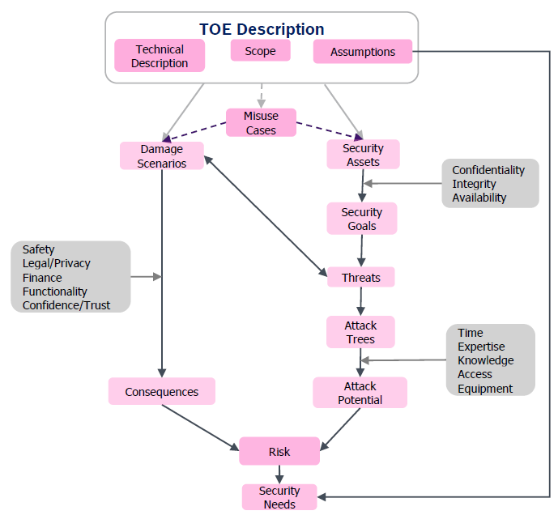
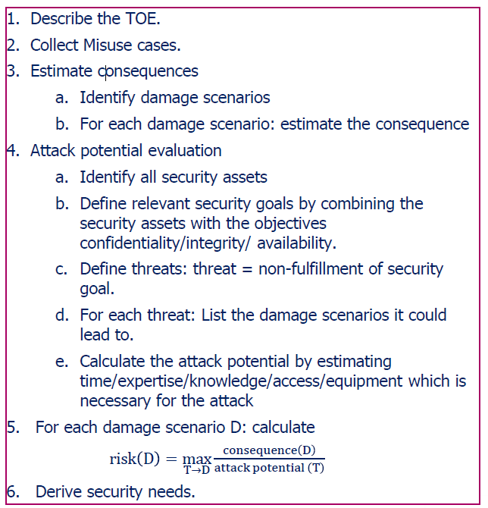
Methodology
TARA

Slide 8
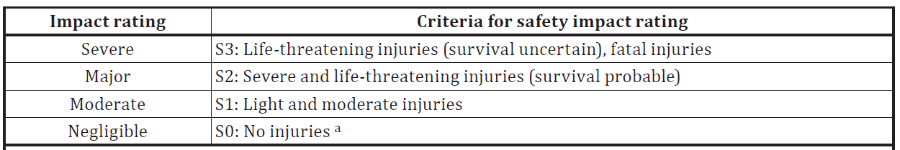
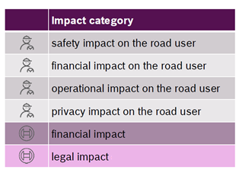
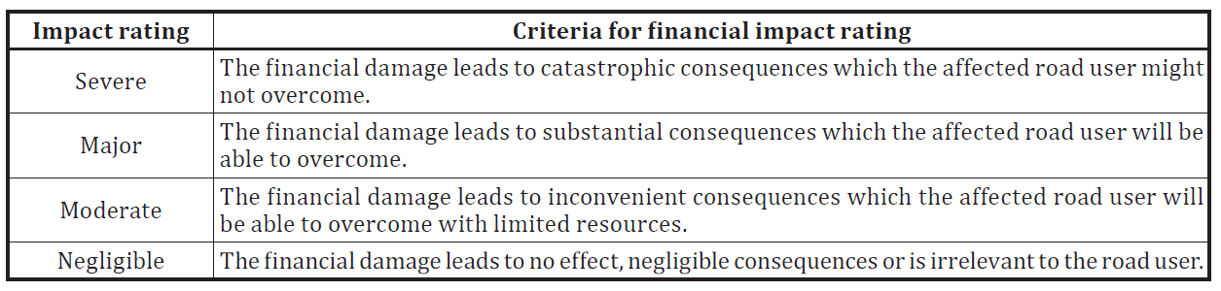
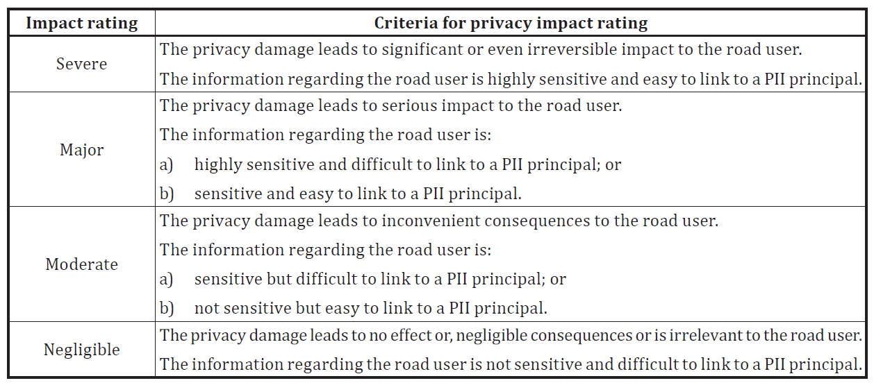
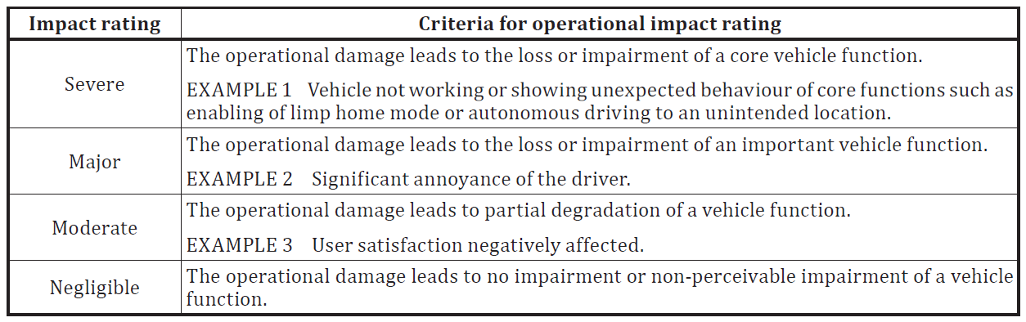
Methodology
TARA

Slide 9
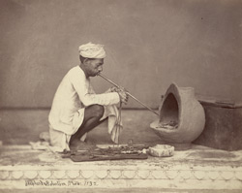
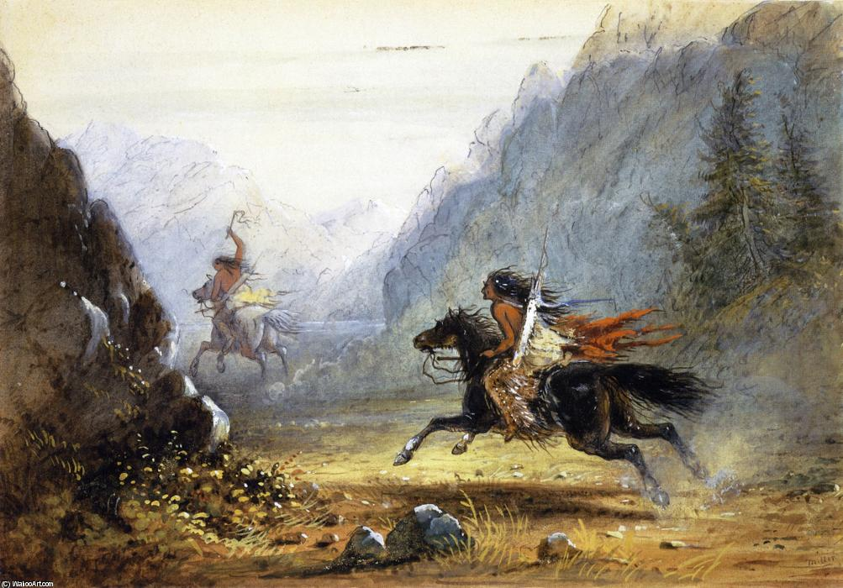
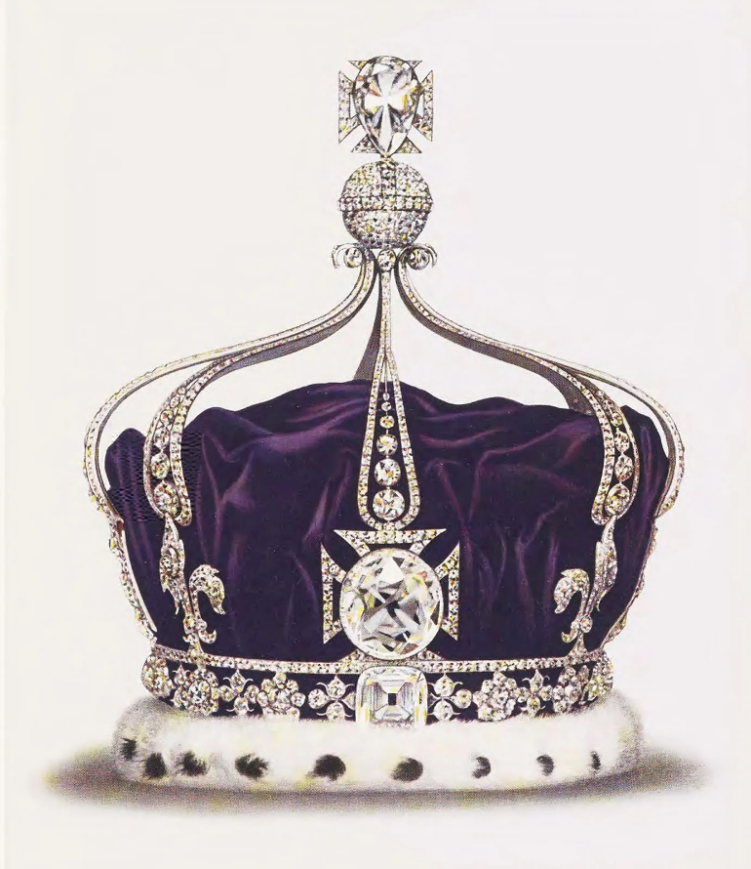
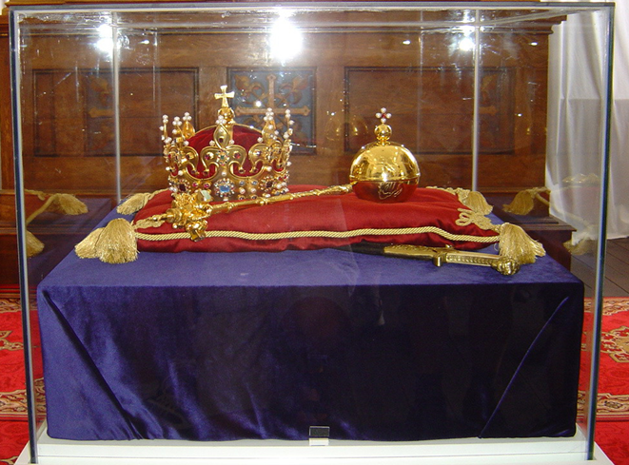
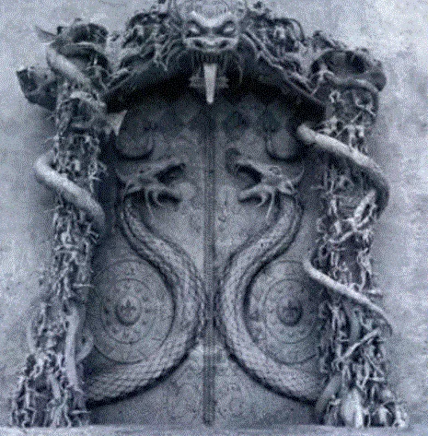
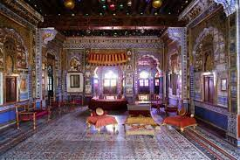
An Example!
TARA
Trustworthy
Theft
Goals
Claims
Crown stored in case
Target
Secure Vault
Access to Queen’s room
Notes:
TOE Description : The TOE is the new crown of princess Anna of Cyberia with all its parts and additional equipment. It needs to be protected so that she can become queen. It is made of gold and has some valuable jewels on it. It is packed into a case for protection. Optionally, it can be enhanced with extra decorations or a matching necklace.
Scope : This analysis considers only Anna's crown with all parts and accessories.
Only attackers from within the palace are considered. Outside attackers are outside the scope of this analysis.
Security Claims :
1. It shall be ensured that the designer of the crown is trustworthy and has completed the required training. The supplier shall ensure that the jewels are properly attached to the crown.
2. The crown shall always be stored in its case.
3. The door of Anna's chamber shall be always locked and Only trustworthy entities shall have access to the key for Anna's chamber door.
Security Goals :
The crown must be protected from theft.
The crown shall be stored in a secure crown vault when it is not in transport.
The confidentiality of the crown spec shall be protected.

Slide 10
An Example!
TARA
Assumptions
Damage Scenario
Jewels are properly attached
Crown is stored in case
Designer is trustworthy
Damage to crown - Negligible
Embarrassment - Moderate
No Queen - Severe
Misuse Cases
Steal the crown and jewels
Create Fake model
Break crown
Assets
Threats
Crown - C,I,A
Jewels - A
Specifications - C
Extraction of Crown
Manipulation of Crown
Blocking Crown

Slide 11
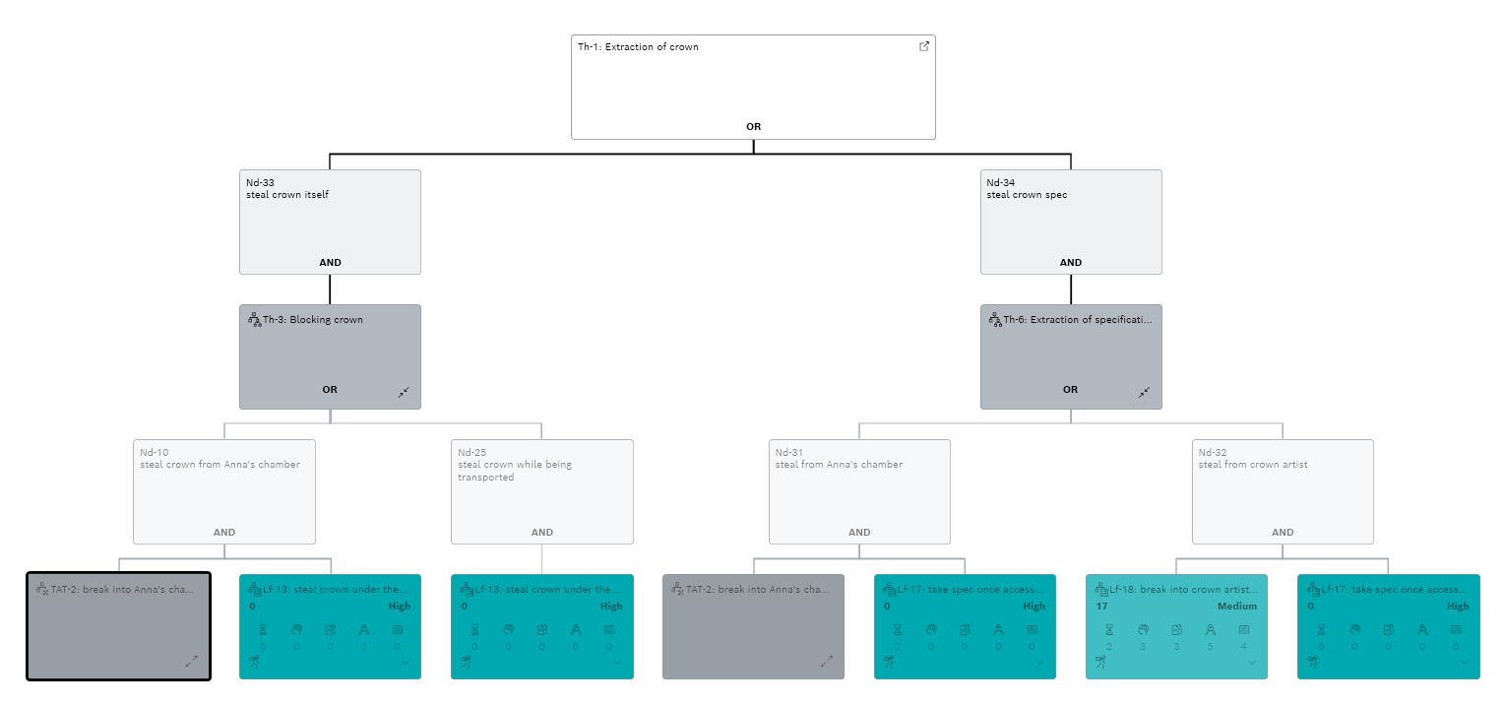
Extraction of Crown
TARA

Slide 12
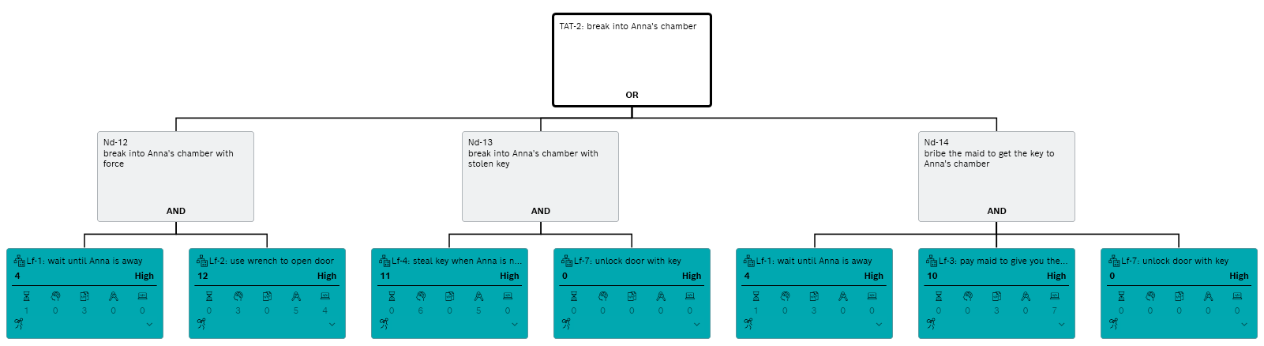
Break into the Queen’s chamber
TARA

Slide 13
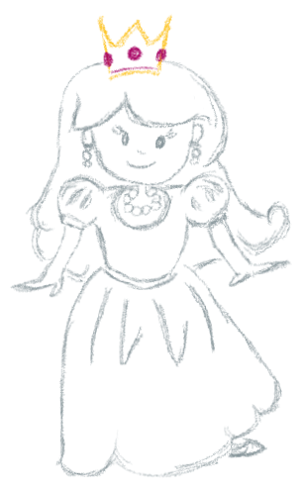
Risk Treatment
TARA
Threat : Extraction of Crown
Security Claim : The door of the queen’s chamber shall be locked.
Only trustworthy entities shall have access to the key for queen’s chamber.
Security Goal : The crown must be protected from theft.
The crown shall be stored in a secure vault.
Damage Scenario : No Queen
Treatment : Reduce
Summary : Crown of the princess has been analyzed in detail and shall be protected with security measures. Queen’s successful coronation can be ensured.

Slide 14
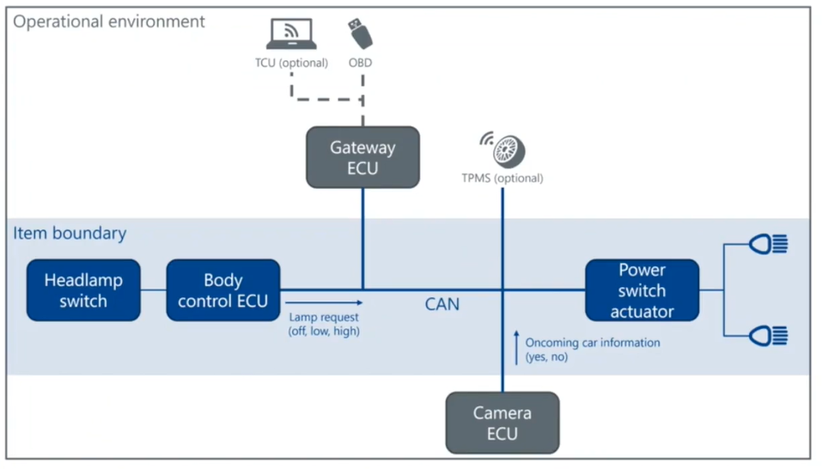
Exercise
TARA
Damage Scenario
Headlamp does not turn on
Assets
Body Control ECU - I
Lamp Request - I,A
Threats
Manipulation of Body Control ECU
Manipulation of Lamp Request
Blocking Lamp Request

Slide 15
Exercise
TARA
Manipulation of Body Control ECU
Flashing a malicious software
Identify & exploit Vulnerability
Downgrade software & exploit
Vulnerability
Access to Vehicle
Obtain Object Files
Flash the software
Access communication
channel
Identify an exploit
Prepare an exploit
Physical Access
Impersonate
Physical Access
Secure Flashing (Security Need)
Downgrade protection

Slide 16
Thank you

